Slide 1
CNIC Resources And Activities Update
Kejun Dong, Kai Nan
CNIC/CAS
Resources Working Group
PRAGMA11 Workshop, Oct.16/17 Osaka, Japan

Slide 2
Outline
CNIC Tiled Display Wall
CNIC Grid Testbed
LCG Testbed and EUChinaGrid
Notes:
This is the outline.

Slide 3
Tiled Display Wall @ CNIC
A Tiled Display Wall (TDW) is a large-scale high-resolution display
CNIC’s TDW is setup at 2005, supporting by Chinese Academy of Science.
Uses a five by four grid of LCDs and 21-nodes cluster running Rocks.
1Gigabit network for each node.

Slide 4
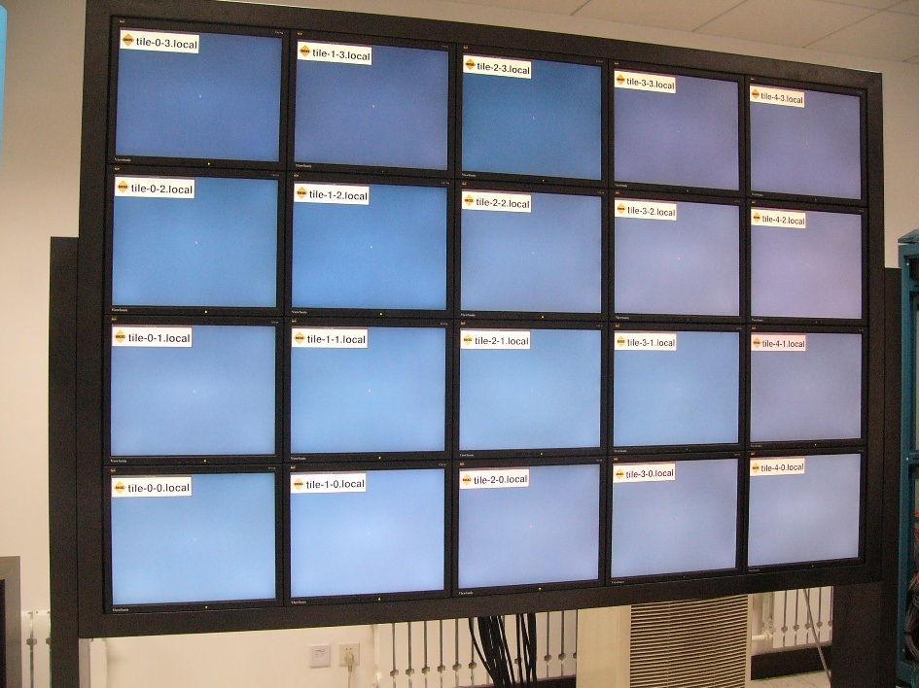
LCD grid
ViewSonic 17’ LCDs

Slide 5
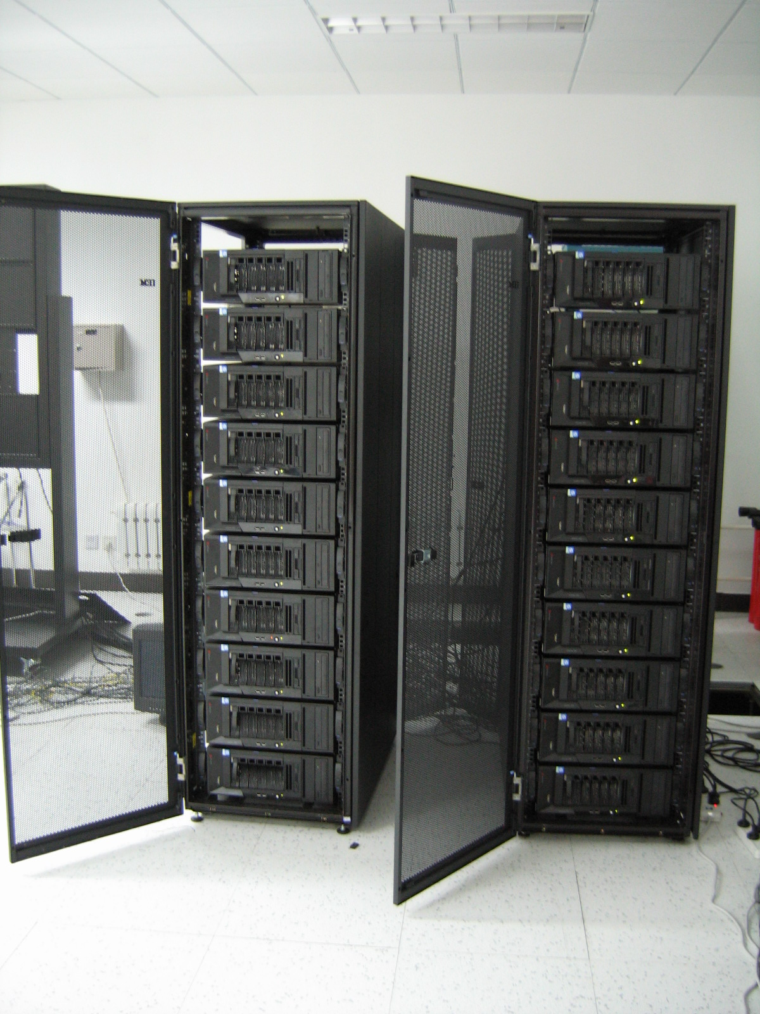
1+20 Cluster
IBM xSeries 226 Server
  Xeon2.8GHz
  1G Memory (frontend 3G)
  Dual Gigabit Network
  73G SCSI Harddisk
  Nvidia 128M Video adapter

Slide 6


Visualization Software Package
Rocks Viz Roll – SDSC
SAGE - EVL/UIC

Slide 7
Astronomical Data Visualization
A PRIME 2006 Project
  2006.6-8
  Supported by NSF
  Using CalIT2 TDW and CNIC’s TDW
  Finished by Elaine Liu (UCSD) at CNIC
To remotely visualize high resolution astronomical images on UC San Diego’s tile display wall while controlling at CNIC and to gain more knowledge about astronomy.

Slide 8
CNIC Grid Testbed Update
One node of PRAGMA Testbed
Update the Job Scheduler
  LJRS (OpenPBS liked) -> SGE 6.0
Website
Try to upgrade Globus Toolkit
  Now – GT2.4.3
  Future – GT4
  We have some problems
    IA64 architecture/RedHat Linux AS 2.1

Slide 9
LCG Testbed @ CNIC
EGEE
LCG stands for ”LHC Computing Grid”
Hardware (Each node)
  4* 1.3 IA64 CPU
  8G Memory
Components
  Computing Element (CE)
  Working Nodes (WN) * eight
  User Interface (UI)
  Berkely Database Information Index (BDII)
  RGMA-based monitoring system collector server (MON)
In Production/ Certificated Mode
Notes:
GIN Testbed

Slide 10
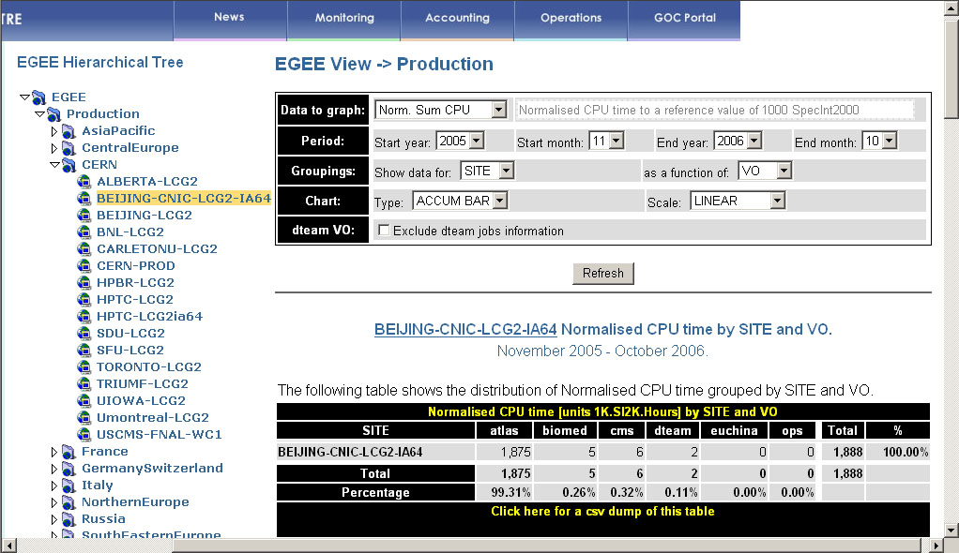
EGEE Grid Operation Center

Slide 11
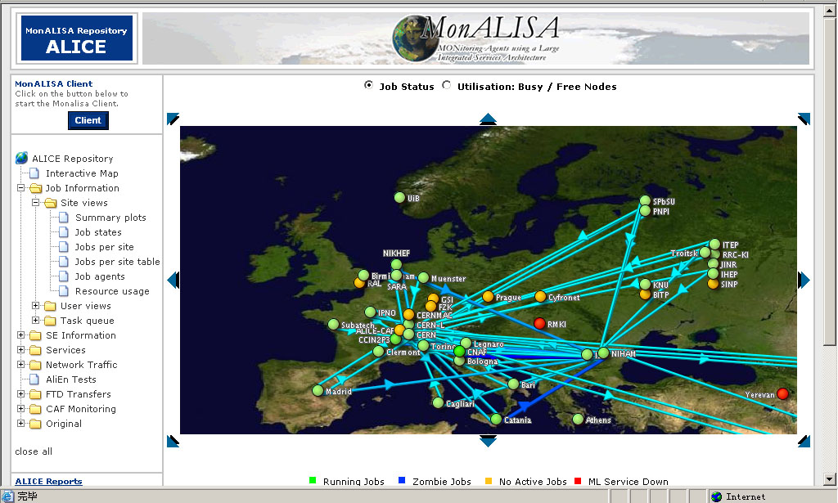
Monitoring with MonALISA

Slide 12
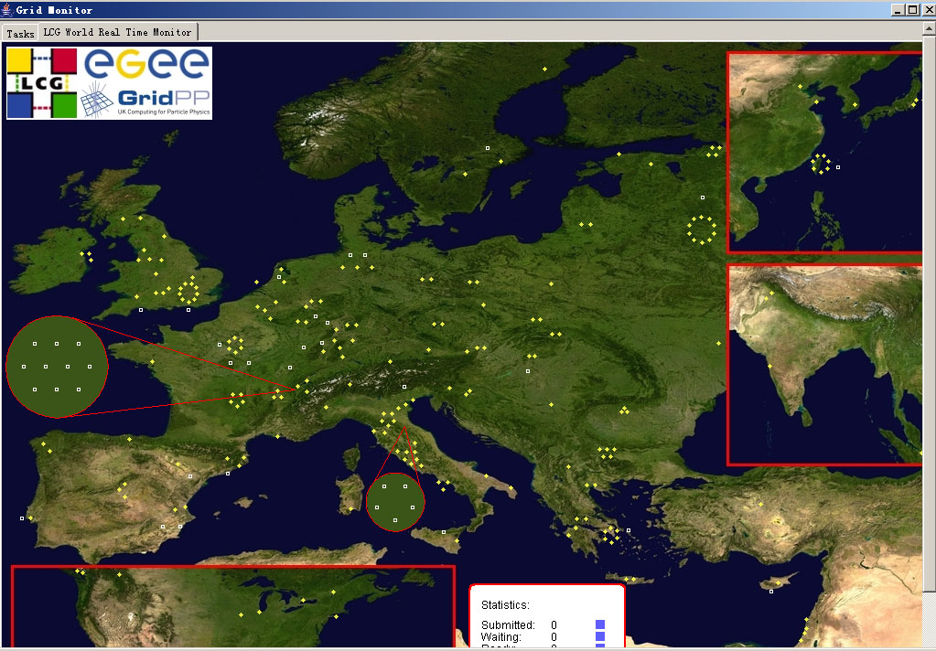
LCG Real Time Monitor

Slide 13
Enabled Virtual Organization
Dteam/ops VO
Euchina VO
Others
  CMS
  Biomed
  Atlas
  argo

Slide 14
EUChinaGrid
Target
  To foster the creation of a intercontinental eScience community
    Training people
    Supporting existing and new applications
  To support interoperable infrastructure for grid operations between Europe and China

Slide 15
Partners - EUChinaGrid
Beihang University, Beijing (China)
CNIC/CAS, Beijing (China)
IHEP/CAS, Beijing (China)
Peking University, Beijing (China)
GRnet (Greece)
Consortium GARR (Italy)
INFN (Italy)
Jagiellonian University in Krakow (Poland)
CERN (Switzerland)

Slide 16
Objectives - EUChinaGrid
Contribute to the creation of an human network promoting international collaboration
Disseminate European experience in China and confront with Chinese experience
Support interoperability of EGEE with the corresponding infrastructure in China, fronting the multi-protocol (IPv4/IPv6) network infrastructure
Use existing network infrastructure and foster its development
Foster interoperability of solutions across different disciplines to achieve broader scale uptake of Grid technology
Harmonize European, and Chinese eScience user and infrastructure requirements in terms of resources needed, Grid services, and application software. Provide recommendations for adapting the present best practices and tools (Virtual Organizations, Certification Authority, Policies, etc.).

Slide 17
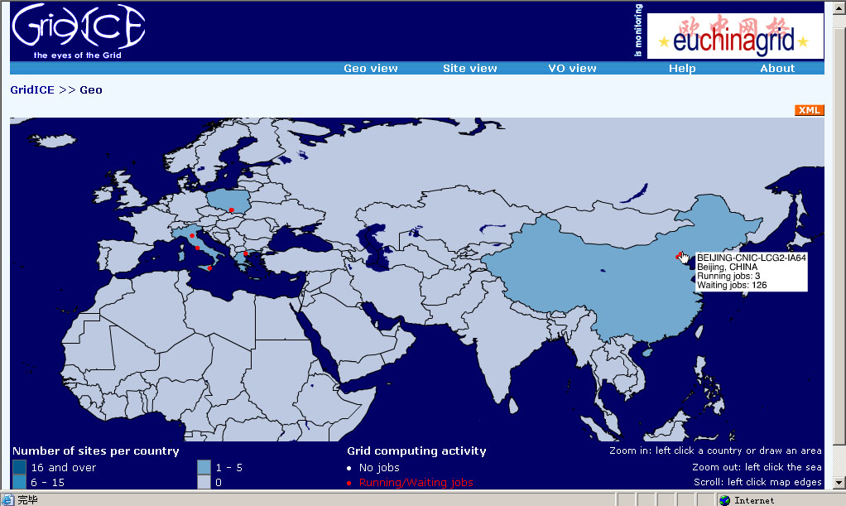
EUChinaGrid GridICE - Geo

Slide 18
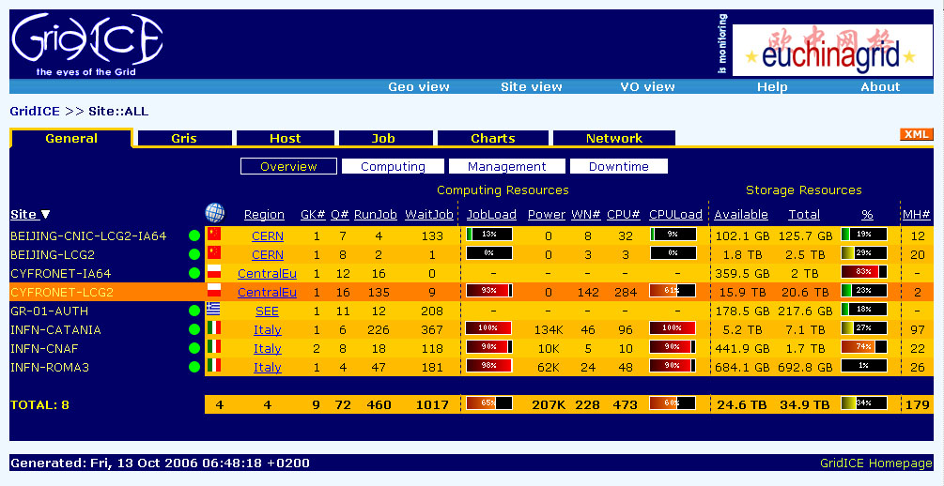
EUChinaGrid GridICE

Slide 19
In short
LCG Testbed:
  Grid-enabled software
    Easy to use
  VOMS
    Virtual Organization Membership Service
    Based on certificate
  Information index
  …

Slide 20
We hope & think…
Experience sharing between LCG Testbeds and PRAGMA Testbeds
The inter-operation between LCG Testbeds and PRAGMA Testbeds
  ? -> ! (GIN Testbed Does!)
……
Notes:
VOMS

Slide 21
Any Comments ?
Thank you!

